Slide 1

Continual Learning on Edge Using TensorFlow-Lite
May 2023
Presentation by Nikolas Stavrou
Department: Computer Science
Supervisors: Dr. Chris Christodoulou | Dr. Vassilis Vassiliades
Notes:
Kalisperisma kai pios eimai k to thema mou
Efxaristies sto koino an exei k stous supervisors
10 sec discussion on title kai paw para katw

Slide 2
Introduction – Continual Learning
What is Continual Learning?
Do we need Continual Learning?
Machine Learning vs Continual Learning
Notes:
Simandiko na min milisw poli ora edw dioti den tha prolavw meta. Grafw mono ta simantika idalios tha milaw poli ora.
Apla etsi mia sintomi anaphora tu oti to cl einai I dinatotita machine learning sistimatwn na mathenun sinexws kai na prosarmozonte se nea dedomena me tin parodo tu xronou xwris na ksexasun tin proigumeni gnwsi pou apektisan.
Sto traditional ml sinithos ekpedevumen ta modela me statika datasets kai ipothetume oti ola ta training data einai diathesima apo tin arxi.
Exume senaria opou ta data allazun dinamika kai emfanizontai se metepita xronikes stigmes. Se etsi periptoseis tha eprepe kathe fora na kanume retrain olo to mondelo me ola ta dedomena pou exume kathe xroniki stigma kati pou einai poli time consuming kai computationally expensive. Edw erxete to continual learning pou mas epitrepei na kanume retrain kai na prosarmozume to modelo mas se real-world scenaria me non stationary data xwris na xriazete na kanume epanekpedefsi kathe fora se ola ta data.

Slide 3
Introduction – CL on Edge
Real-Time On-Device training
Faster model adaptation
Reduction of required computational resources
Notes:
Lew ti extra apetiseis exume apo ta cl models mas sto context pou thelume na ginun deployed on Edge.

Slide 4
Introduction – Thesis Goals
Application
Deploy CL models on Edge Enable on-device real-time training Easy model customization and management
Experiments
Evaluate models performance on CL scenarios Models optimized for Edge Deployment
Notes:
Apla tha milisw ligo gia afta ta points pou vlepw kai na pw oti to thesis exei 2 ptixes

Slide 5
Table of Contents
01
02
03
Background
Previous Work
Application Implementation
04
05
06
Experiments
Conclusion
Future Work

Slide 6
Background

Slide 7
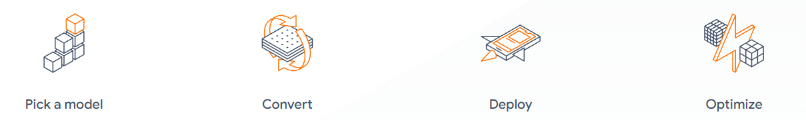
TensorFlow & TensorFlow-Lite
TensorFlow
TensorFlow-Lite
Open-source ML/AI library developed by Google
Lightweight TensorFlow version for mobile and edge devices
https://www.tensorflow.org/lite
Notes:
Simple description of TF and TF-Lite

Slide 8
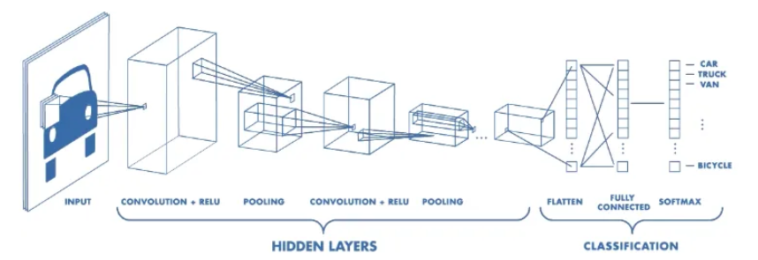
MobileNetV2
Convolutional Neural Network Architecture
Optimized to perform well on mobile devices
Object Detection, Image Classification etc.
https://medium.com/@RaghavPrabhu/understanding-of-convolutional-neural-network-cnn-deep-learning-99760835f148
Notes:
Na pw poli periliptika ti einai CNN kai oti to MobileNetV2 einai cnn kai oti vlepw sto slide vasika.

Slide 9
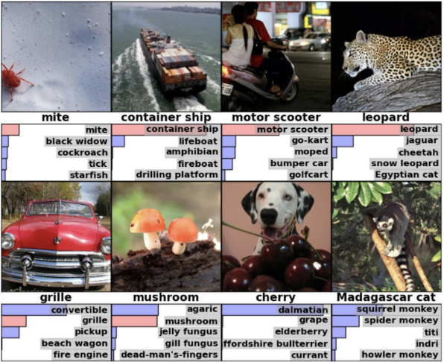
MobileNetV2 - ImageNet
Pre-trained on ImageNet
1000 object classes
1.2M train & 100k test Images
https://thegradient.pub/nlp-imagenet/
Notes:
After saying on mobilenetv2 that it was pretrained with the ImageNet:
Image database
1000 object classes
1.2 million images for training
100k images for testing

Slide 10
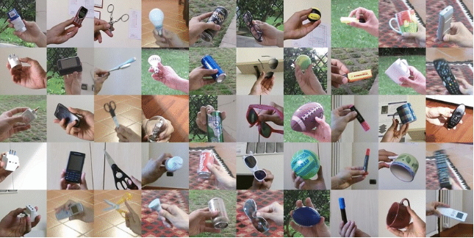
CORe50
A continuous object recognition dataset
50 objects 16500 images Both new instances and new classes NICv2 – 391 (391 training batches)
https://arxiv.org/abs/1705.03550
Notes:
Talk about the dataset
Explain the different continual learning scenarios maybe
New Instances
New Classes
This will lead to say the NICv2 – 391 (probably skip this, no time)

Slide 11
Continual Learning Strategies
Architectural
Regularization
Multi-Head
Progressive Neural Networks (PNNs)
Learning Without Forgetting (LWF)
Elastic Weights Consolidation (EWC)
Continual Learning
Rehearsal
Hybrid
Random Replay
Latent Replay
Generative Replay
GEM
iCarl
AR1* w/ Latent Replay
Notes:
Anafernw ligo tis 4 katigories kai lew 1-2 apo ta bullets (skip this no time). Lew oti Rehearsal mas niazei emas dioti kanume random kai latent replay

Slide 12
Model deployed on Edge
03
Fine-Tuning
Head
Solve specific task
02
03
On-Device Training
Weights change
01
Model
Replay Buffer
03
Pre-trained
MobileNetV1/V2/V3, EfficientDet etc.
02
03
Frozen
Body
Used for feature extraction only
Notes:
Perigrafw tin domi tou model

Slide 13
Previous Work

Slide 14
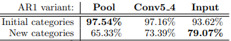
Previous Work
Latent Replay for Real-Time Continual Learning
L. Pellegrini, V. Lomonaco et al. (2020) AR1* extended with latent replay Replay Buffer at a latent layer Full pace training after the latent layer Slow training before
Continual Learning at the Edge: Real-Time Training on Smartphone Devices
L. Pellegrini et al. (2021) AR1* w/ latent replay deployed on android application CORe50 used for 10 initial categories Extended with 25 objects, 5 categories, 12 sessions for each
Notes:
Talk for latent replay first since 2nd is continuation
To pool conv5_4 kai input dixnei to layer pou ginontai save ta features twn eikonon se replay buffer.

Slide 15
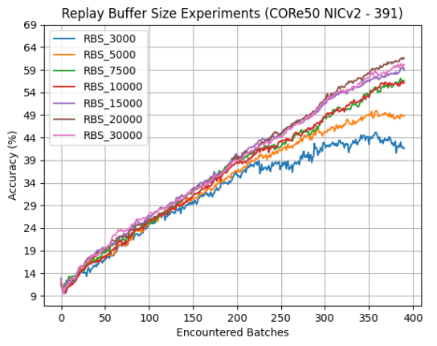
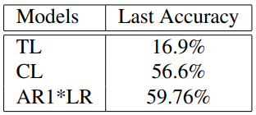
Previous Work
Continual Learning on Edge with TensorFlow Lite
G. Demosthenous, V. Vassiliades (2021) Body: Frozen MobileNetV2 Head: Simple Dense Fully-Connected Layer + Classification Layer On-Device training Enhanced TensorFlow-Lite capabilities with CL Deployed on mobile device
https://arxiv.org/abs/2105.01946
Notes:
Just describe slide

Slide 16
Dual Objectives
Application Implementation
Offline Experiments
Updated TF-Lite application
Improve CL model from previous work
Extended with CL
Four main changes
Use of Replay Buffer
Evaluate on CORe50
How we can improve?
Notes:
Again simply describe slide

Slide 17
Application Implementation
Notes:
Na anaferw oti tha dume pws dulevei I efarmogi, ti pleonektimata mas prosferei I kainurgia efarmogi, kai pws tin kaname expand gia na exume continual learning

Slide 18
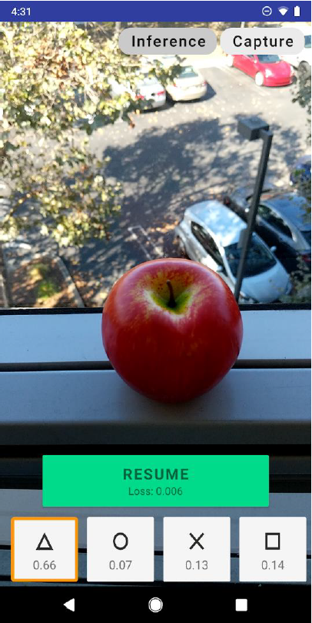
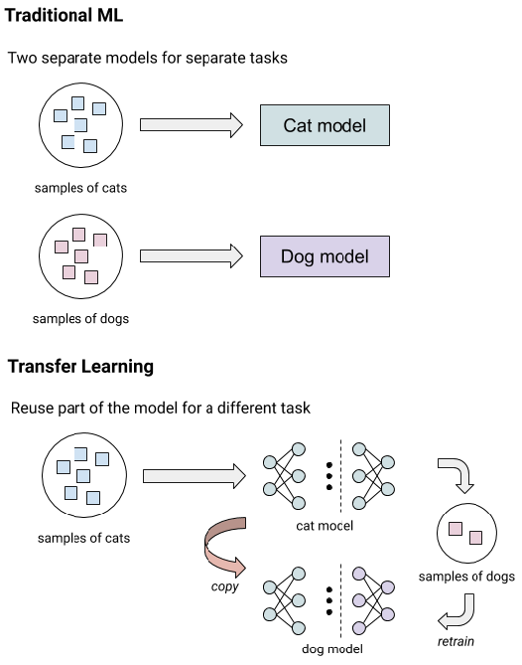
Old and Updated TF-Lite App
On-Device Training
Four Classes
No Incremental Learning
Uses Transfer Learning
MobileNetV2
Pre-trained on ImageNet
https://blog.tensorflow.org/2019/12/example-on-device-model-personalization.html
Notes:
Milw ligo gia to app, ta aristera
Meta anaphora se transfer learning mobilenetv2 oti einai to body mas

Slide 19
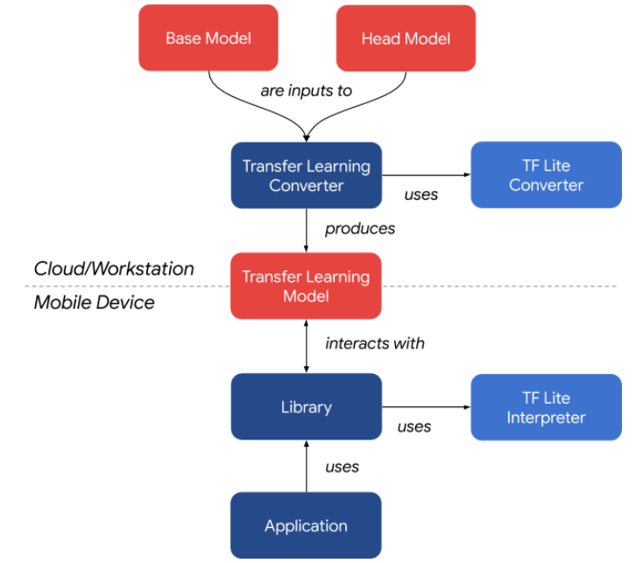
Old and Updated TF-Lite App
https://blog.tensorflow.org/2019/12/example-on-device-model-personalization.html

Slide 20
CL on Updated TF-Lite App
 | Advantages of expanding the Updated TF-Lite App with CL capabilities
1 | Easier customization of model structure -> More flexibility
2 | Simplified model management
3 | Single Tensorflow Lite model
4 | Use of tf.functions for defining bottleneck loading, training, inference etc.
5 | Easy way to save and restore training weights
6 | Easier for developers to create personalized applications
Notes:
Simplified model management vs old app where you had separate .tfmodels for optimizer, initialization, inference, training and bottleneck was super complex procedure.
Apla perigrafi, tha ithela na anaferw sto 4 oti exume signatures sta functions.
To 6 einai vasika sinopsismos olwn oti einai easier

Slide 21
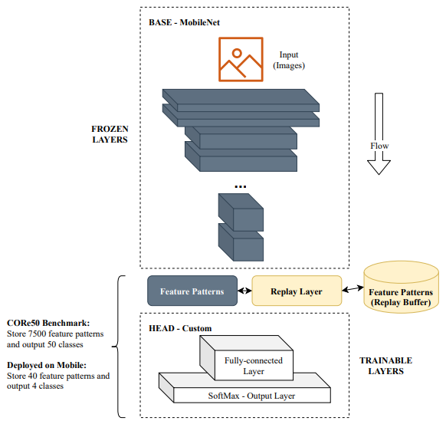
Expanding TF-Lite App to enable CL
Addition of Replay Buffer
Replaying feature patterns
Testing default TL app vs CL one
with different scenarios
https://arxiv.org/abs/2105.01946

Slide 22
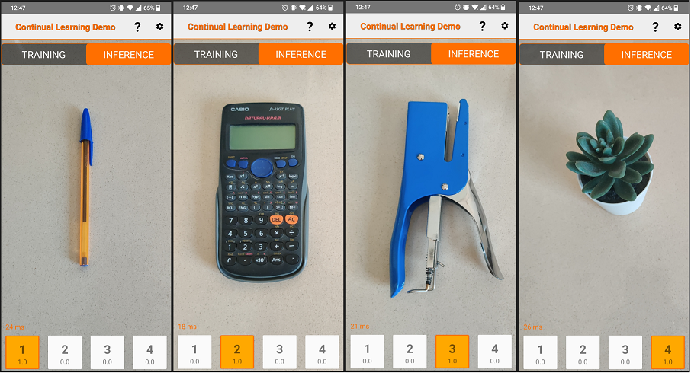
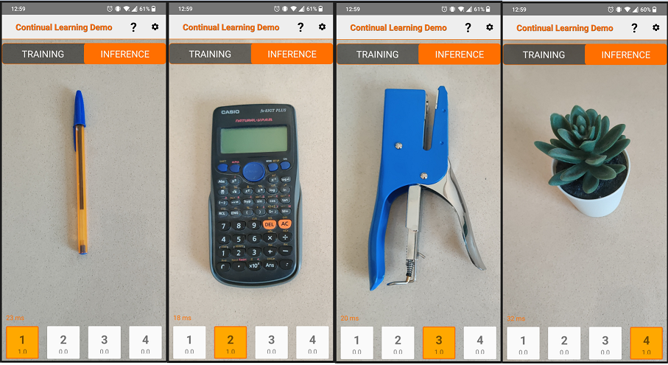
Scenarios on CL TF-Lite App
Cumulative Scenario
TL model
CL model
Notes:
50 samples from each class, trained both models using all 200 samples (no replay occurred)

Slide 23
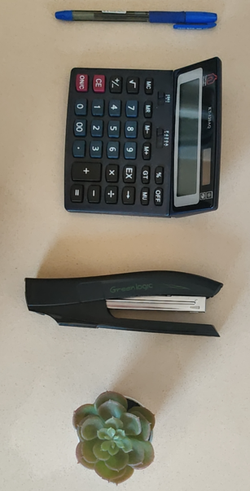
Scenarios on CL TF-Lite App
New Instances Scenario
Four new samples used for the Scenario

Slide 24
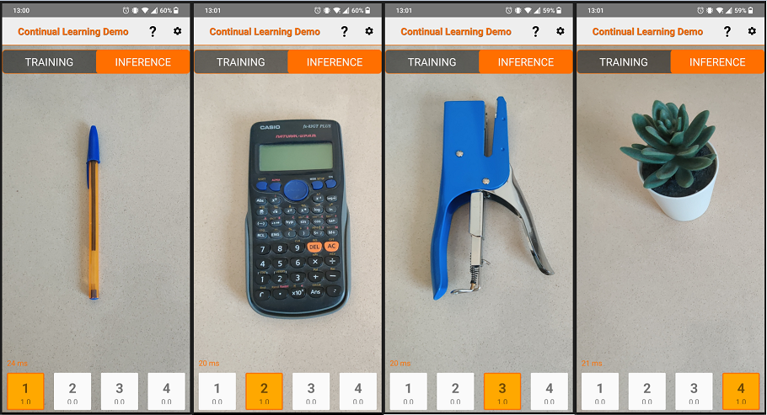
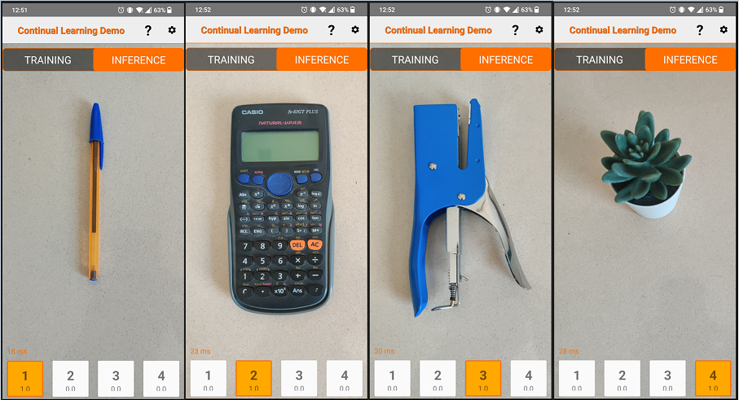
Scenarios on CL TF-Lite App
New Instances Scenario
TL model
CL model
Notes:
Training both models with 200 samples total. replay buffer filled with 40 samples (20%)
Train again with 20 new samples per class (80total)
In the cl model, the new training is done with the replay buffer samples as well

Slide 25
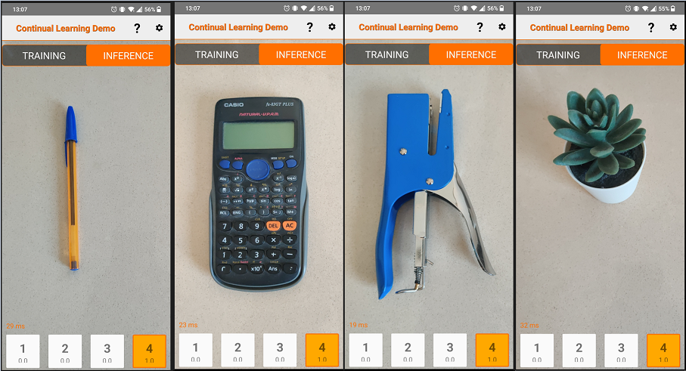
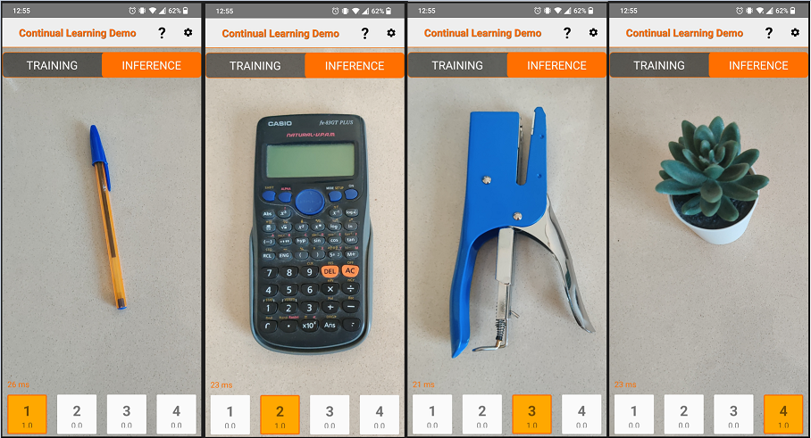
Scenarios on CL TF-Lite App
New Classes Scenario
TL model
CL model
Notes:
A more natural setting. Incrementally introduce classes.
50 samples for each class and train. Then introduce next class train, etc. 10 samples from each class are added every time to the replay buffer.

Slide 26
Experiments

Slide 27
Experiments – Methodology 1
01
Experiment with altering model
Improve performance
02
Benchmark – CORe50
CORe50 NICv2 – 391 scenario
03
Replay Strategies
Remain suitable for edge deployment
04
Load dataset, Build Model, Train, Evaluate
Notes:
Apla ta lew

Slide 28
Experiments – Methodology 2
Sequential vs Simultaneous Training
01
02
Algorithm for Storing New Samples
Changes Made
Latent Replay Strategy
Replay Buffer Sizes
03
04
Notes:
Apla ta lew

Slide 29
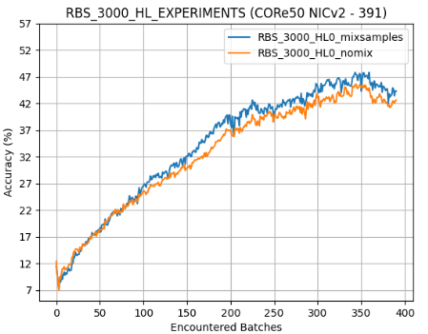
Experiments – Results 1
Sequential vs Simultaneous Training
Original Model: Two - step training process New Approach: Concatenate and shuffle New Samples and Replay Buffer Samples Four Epochs training of each batch
Peak accuracies:
45.5% vs 47.8%
Notes:
Two-step training process:
First new training samples for 3 epochs
Then replay buffer samples for 1 epoch

Slide 30
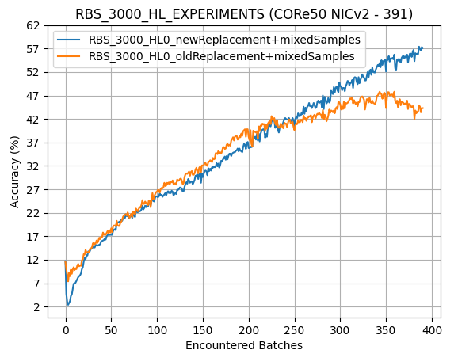
Experiments – Results 2
Storing New Sample Representations in the Replay Buffer
Original Model: 1.5% Random Sample replacement New Approach: Random replacement based on RB Size / Training Batch Number Less Replacements the further we are in the training batches
Peak accuracies:
47.8% vs 57.4%
Notes:
Discuss the new algorithm approach and why it performs better
Mentioning of CORe50 that at the end we show previous classes again

Slide 31
Experiments – Results 3
Latent Replay Strategy - Explained
Moving HL from MobileNetV2 (Body) to our model head
Bottleneck is obtained earlier, moved layers are trainable
Replay still occurs before the head of the model
Notes:
Explain the strategy. Can mention the paper that introduced it but clarify that ours is a bit different since it has to do with moving layers from body to head

Slide 32
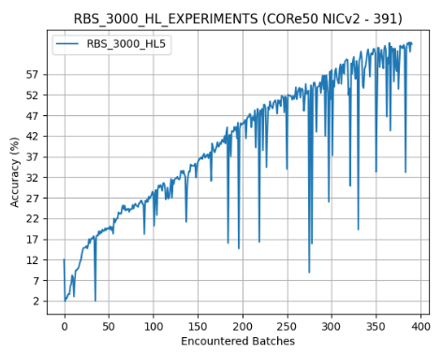
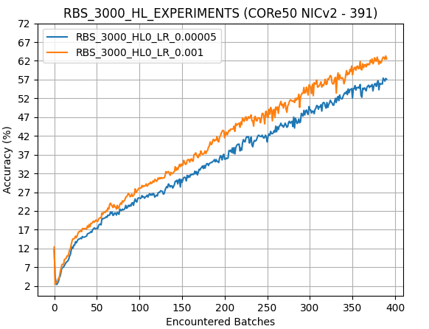
Experiments – Results 3 Cont.
Latent Replay Strategy - Learning Rates
Peak accuracies:
57.4% vs 63.3%
Learning Rate = 0.01
Notes:
Discuss the different learning rates. Original was 0.00005, higher one is definitely needed to help with training of the head.
Too much increase in learning rate and we have misclassifications

Slide 33
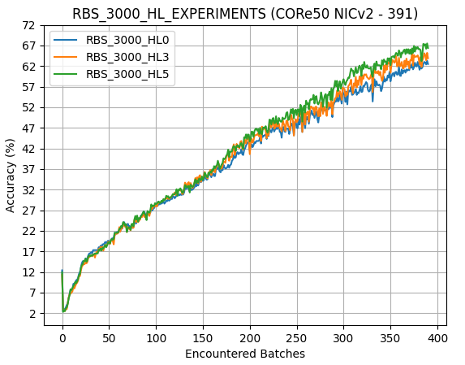
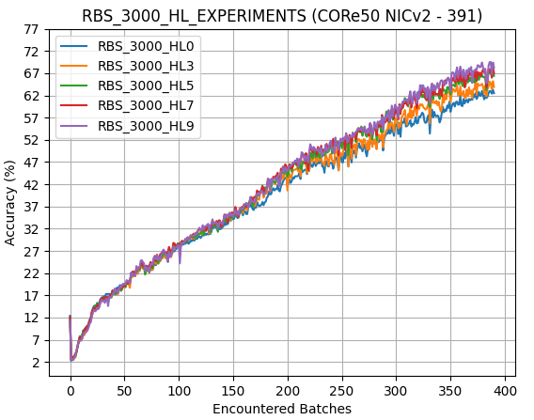
Experiments – Results 3 Cont.
Latent Replay Strategy – Latent Replay on different layers
Peak accuracies (0, 3, 5):
63.3% vs 65.1% vs 67.5%
Peak accuracies (7, 9):
68.4% vs 69.5%
Notes:
Discussion of the more hidden layers passed to the head we get a better accuracy but the increase is not linear

Slide 34
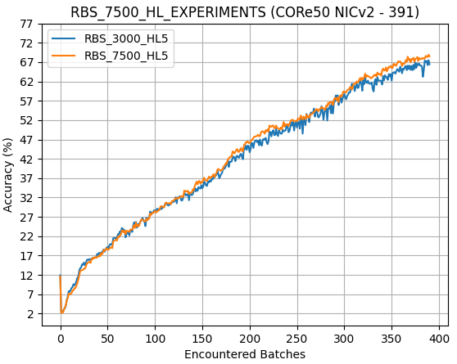
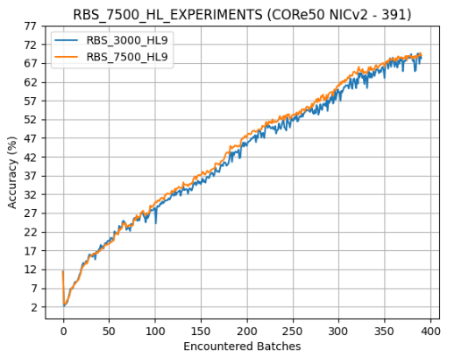
Experiments – Results 4
Replay Buffer Sizes
Peak accuracies:
67.5% vs 68.9%
Peak accuracies:
69.5% vs 69.7%
Notes:
Buffer sizes did not increase accuracies
What they did help however is making the model much more stable

Slide 35
Comparison with Previous Work
Continual Learning on Edge using TensorFlow-Lite
Peak accuracies:
69.5% & 69.7%
https://arxiv.org/abs/2105.01946
Notes:
Compare results. Basically ours achieves better accuracy than all of the different replay buffer sizes used in the previous work.
Of course moving hidden layers adds complexity on the head for on-device training so we study further the trade-offs for moving different layers

Slide 36
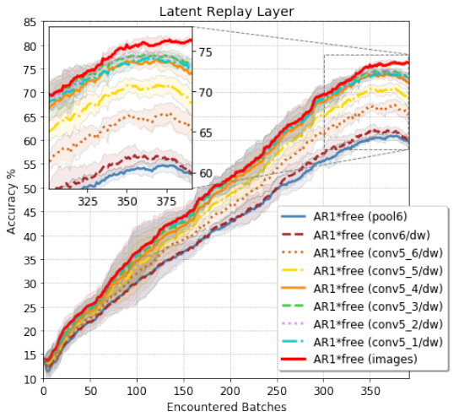
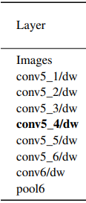
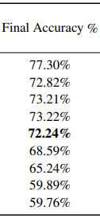
Comparison with Previous Work
Peak accuracies:
69.5% & 69.7%
Latent Replay for Real-Time Continual Learning
https://arxiv.org/abs/1912.01100
Notes:
Compare results. Mention that our results come close to the optimal layer but they used different model the AR1*.
Also:
Conv6/dw is the 3rd hidden layer so it goes 5th, 7th, 9th (bold one), 11, 13, 15 and then from the input layer (all mobileNetv1 layers are 28 which mean he does latent replay to up half of the network)

Slide 37
Conclusion

Slide 38
Conclusion – Two Objectives
Application Implementation
Transition the CL capabilities from the old TF-Lite App to the new one. Successful integration of original model and replay buffer Easy customization Streamlined model management – Single Model Save and Restore weights
Offline Experiments
Further experimentation with CL models Random Replay Strategy Various changes such as Latent Replay Increased model accuracy up to 69.7% Maintained a lightweight model suitable for edge deployment
Notes:
Discuss points

Slide 39
Future Work

Slide 40
Future Work - Application
1 | Deploy the improved model to the application
2 | Expand number of classes (Currently 4)
3 | Evaluate performance of model within the application (Benchmarks)
4 | Preserve model state
Notes:
Expand classes since we proved to get a decent accuracy with the CORe50 dataset (50 classes)

Slide 41
Future Work - Experiments
1 | Further model fine-tuning to increase accuracy
2 | Further testing of sample replacement method of replay buffer
3 | Improve replay buffer with class-balancing (Increased complexity)
4 | Optimal replay buffer size
Notes:
1st – Different optimizers, variable learning rates etc.
2nd – Should experiment more with the replacement method, what if a lot of new classes appear after many training batches (bring it in context of the app). Maybe we need to perform a soft/hard reset etc?
3rd – have class-balancing of samples in replay buffer. Could increase accuracy but not sure because we add a lot of increased complexity
4th – We didn’t increase our replay size and remained at 3000 samples. Other papers have experimented with sizes of 500, 1000, 1500, 3000 etc. We can see what the optimal size it to have decent accuracy without a really big buffer size and utilize the exact one for our application.

Slide 42
Thank you
Notes:
An iparxei opiadipote erwtisi mporeite na rwtisete elefthera

